Slide 1
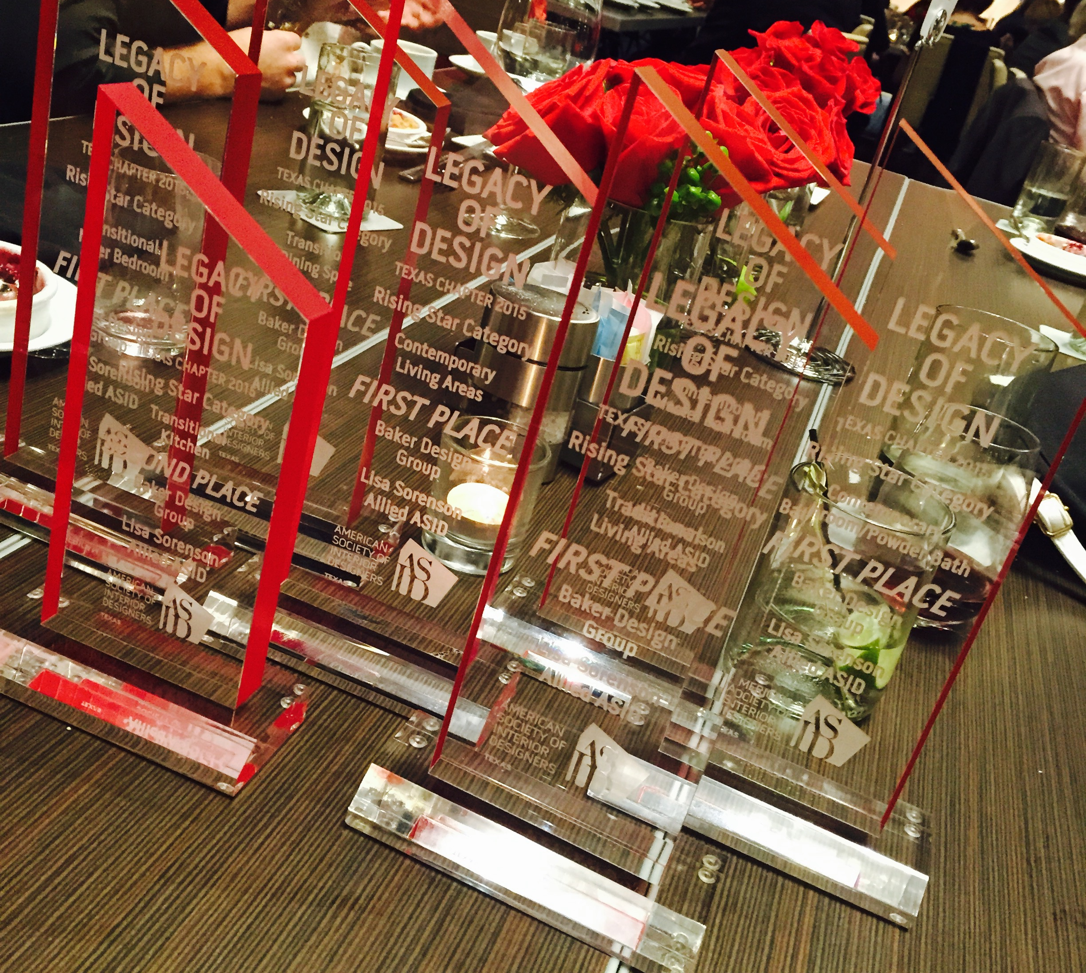
SEVEN-TIME 2015 LEGACY DESIGN AWARD WINNER

